Slide 1

Crescent Plc
“Do discounts and sales lead to more repeat customers, or just one-time purchases?”

Slide 2
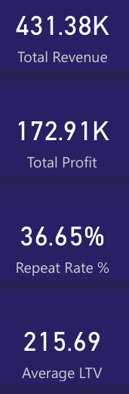
Overall Performance
Total Revenue Reached £431K
Profit of £173K
Repeat Purchases are 36.65%
Average Customer Lifetime Value if £215.69

Slide 3
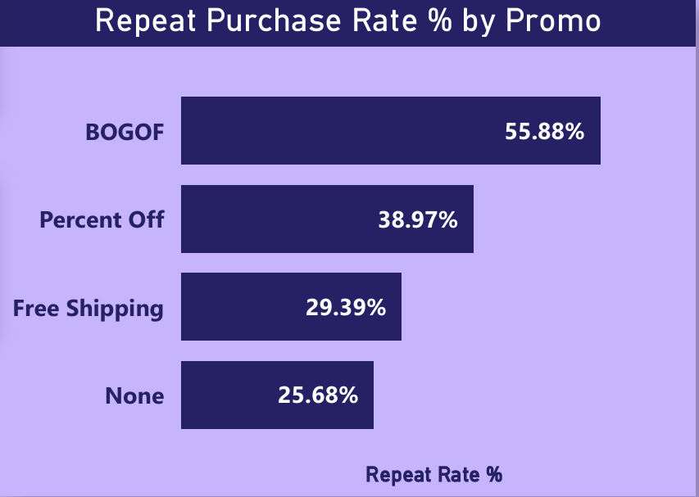
Repeat Rate% by Promotion
DRIVES THE HIGHEST REPEAT PURCHASING

Slide 4
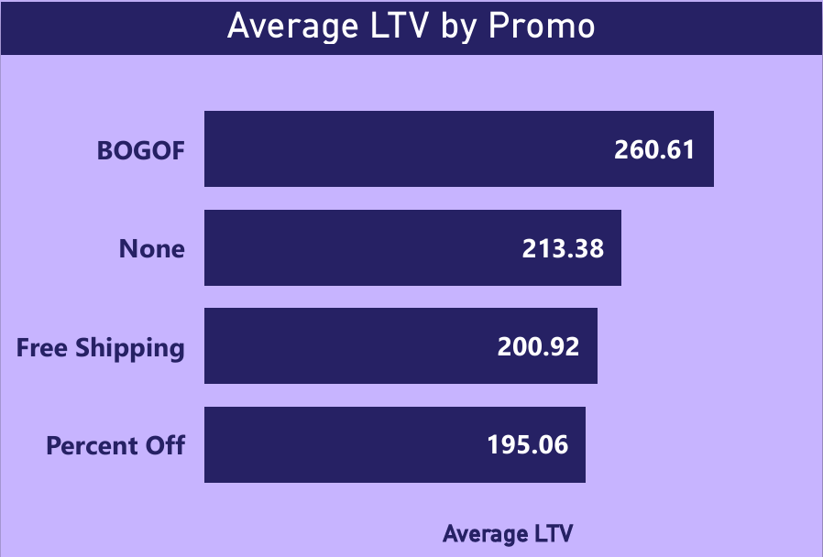
Average LTV by Promotion
GENERATES HIGHEST LIFETIME VALUE CUSTOMERS

Slide 5
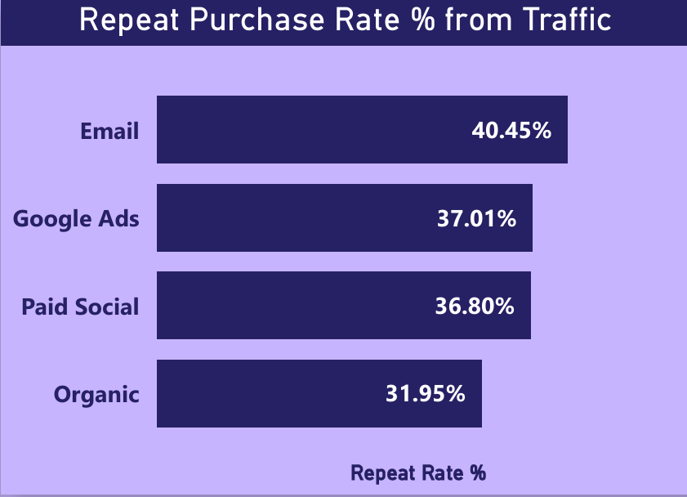
Repeat Rate% from Traffic
EMAILS GENERATE HIGHEST TRAFFIC LEADING TO PURCHASE

Slide 6
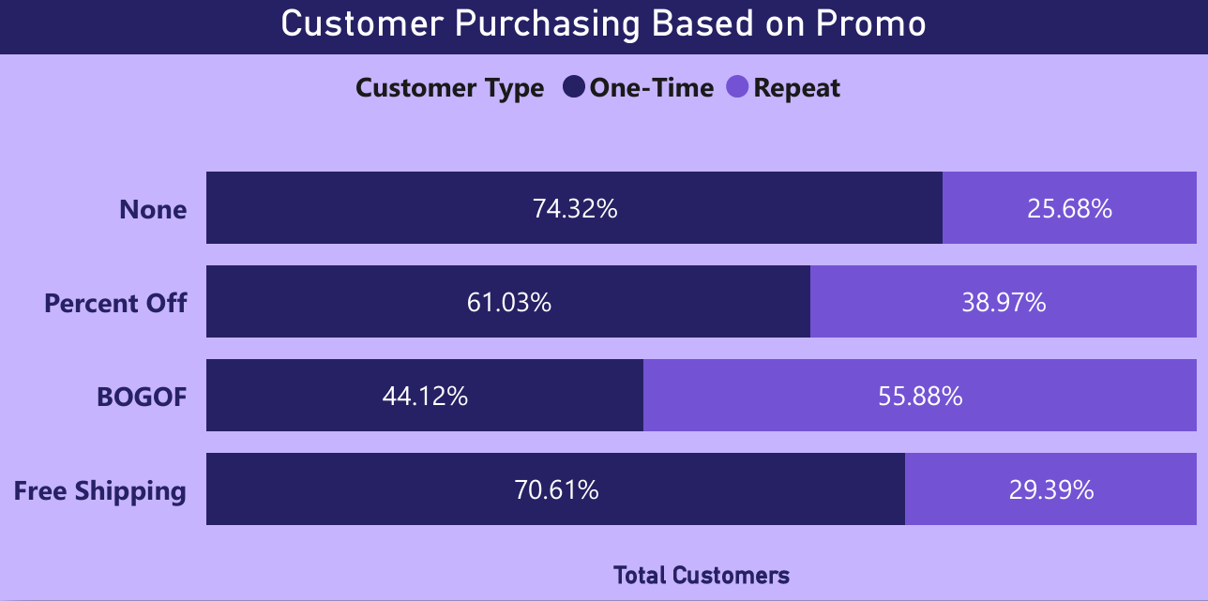
Promotion Based Purchasing
GENERATES LARGEST AMOUNT OF REPEAT CUSTOMERS

Slide 7
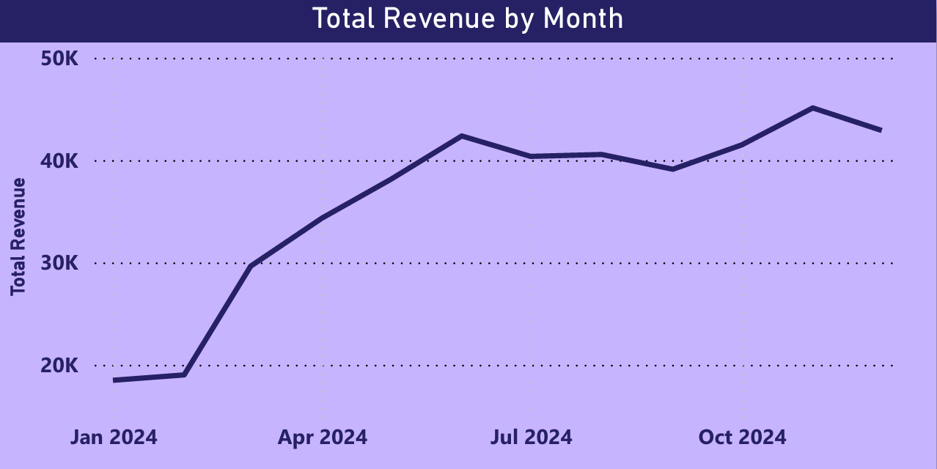
Revenue Trend 2024
POSITIVE TREND,
PEAK AROUND NOVEMBER.
SUGGESTS PROMOTIONS ARE MORE EFFECTIVE BASED ON SEASONALITY

Slide 8
Key Takeaways
BOGOF contributes to the most repeat purchases, is the most valuable LTV.
Email generates the most traffic leading to purchases.
No promotions often lead to one-time purchases.
Positive Revenue Trend 2024.

Slide 9
Recommendations
Prioritise BOGOF promotions, lead to the most customer retention.
Use Percent off and Free Shipping to attract new customers (short term/seasonality).
Utilise Email to promote repeat purchases.
Monitor promotions throughout next quarter.

